Slide 1

CUDA Basics

Slide 2
What is CUDA?
CUDA (or Compute Unified Device Architecture) is a parallel computing platform and application programming interface (API) that allows software to use certain types of graphics processing unit (GPU) for general purpose processing – an approach called general-purpose computing on GPUs (GPGPU).
CUDA is a software layer that gives direct access to the GPU's virtual instruction set and parallel computational elements, for the execution of compute kernels.

Slide 3
"CUDA is a parallel computing platform and programming model that makes using a GPU for general purpose computing simple and elegant."
"The developer still programs in the familiar C, C++, Fortran, or an ever expanding list of supported languages and incorporates extensions of these languages in the form of a few basic keywords."

Slide 4
What is GPU?
The graphics processing unit, or GPU
By contrast, GPUs break complex problems into thousands or millions of separate tasks and work them out at once.
That makes them ideal for graphics, where textures, lighting and the rendering of shapes have to be done at once to keep images flying across the screen.

Slide 5
GPGPU
General-purpose computing on graphics processing units (GPGPU, or less often GPGP) is the use of a graphics processing unit (GPU), which typically handles computation only for computer graphics, to perform computation in applications traditionally handled by the central processing unit (CPU).
The use of multiple video cards in one computer, or large numbers of graphics chips, further parallelizes the already parallel nature of graphics processing.
GPUs incorporate an extraordinary amount of computational capability, they can deliver incredible acceleration in workloads that take advantage of the highly parallel nature of GPUs, such as image recognition.
GPU technology involve AI and machine learning. Many of today’s deep learning technologies rely on GPUs working in conjunction with CPUs.

Slide 6
CPU vs GPU
CPUs, to be sure, remain essential. Fast and versatile, CPUs race through a series of tasks requiring lots of interactivity. Calling up information from a hard drive in response to user’s keystrokes, for example.
CPU | GPU
Central Processing Unit | Graphics Processing Unit
Several cores | Many cores
Low latency | High throughput
Good for serial processing | Good for parallel processing
Can do a handful of operations at once | Can do thousands of operations at once

Slide 7
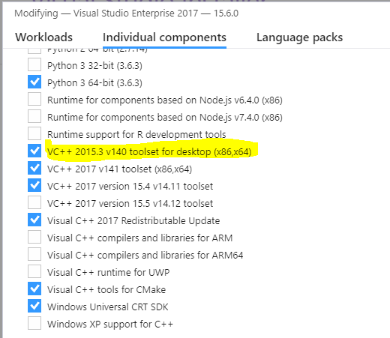
Installation
Based on Windows 10, GTX 1650Ti
Cuda Toolkit
I installed v10.1
You must check the Compute Capability of your Graphic card!
https://developer.nvidia.com/cuda-gpus#compute
Visual Studio 201n Community
I installed 2017
You need to make sure your version supports the CUDA toolkit.
You must check this option on Installation to use CUDA Toolkit
(optional) Latest version of graphic driver

Slide 8
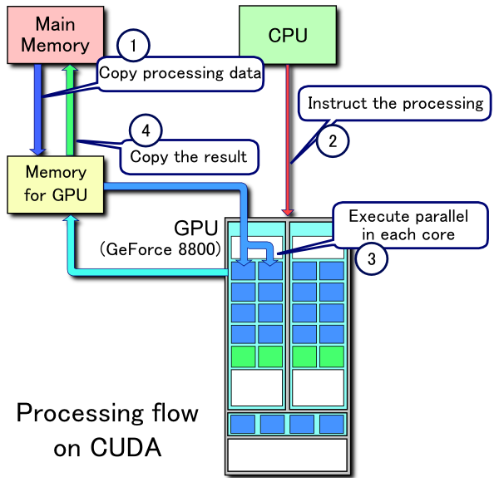
Processing flow of CUDA
Copy data from main memory to GPU memory.
CPU initiates the GPU compute kernel
GPU's CUDA cores execute the kernel in parallel
Copy the resulting data from GPU memory to main memory

Slide 9
TIME
DATA
CPU
initialize()
performWork()
verifyWork()
Time

Slide 10
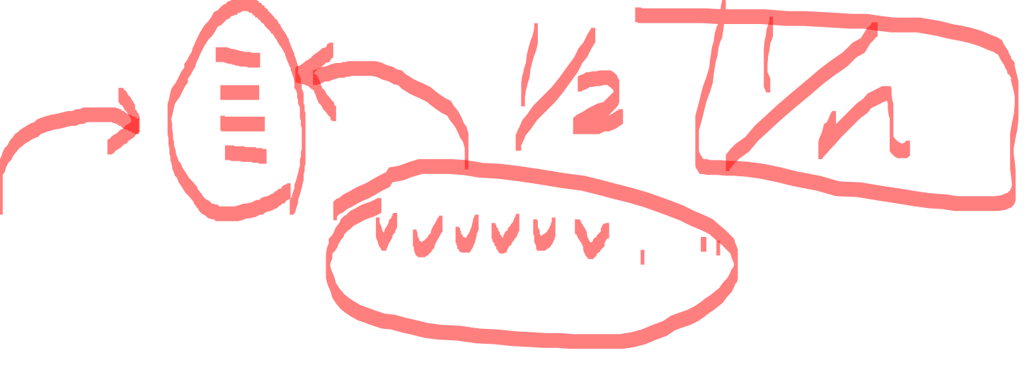
TIME
DATA
GPU
CPU
GPU
performWork()
CPU
initialize()
cpuWork()
synchronize
verifyWork()
Time

Slide 11
Expressions
Kernel
A term for GPU functions.
The kernel is executed according to the execution configuration.
Thread
The basic unit of GPU work
Multiple threads work in parallel.
Block
A collection of threads is called a block.
Grid
A whole group of blocks in the execution configuration of a given kernel is called a grid.

Slide 12
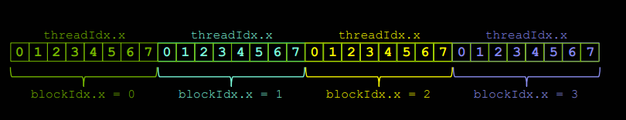
Blocks and Threads
Units for processing GPU (device) code in parallel
One block may consist of N threads.

Slide 13
Blocks and Threads
The number of threads that can exist in each block is limited to a maximum of 1024
Therefore, in order to enjoy the effect of parallel processing to a greater extent, the coordinates between several blocks must be well coordinated.

Slide 14
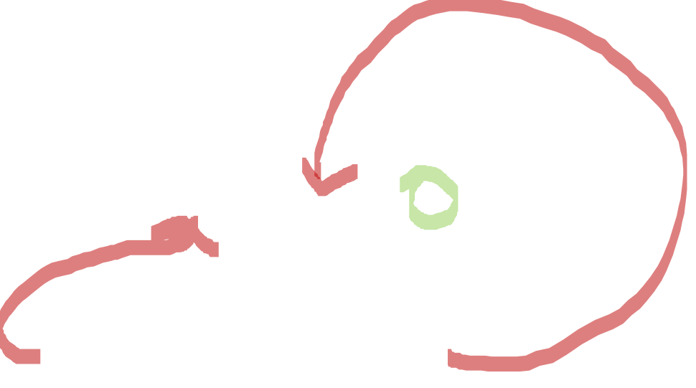
Basics
__global__ void kernel( void ) { }
int main() {
kernel <<< 1, 1 >>> ();
printf( "Hello, World!\n" );
}

Slide 15
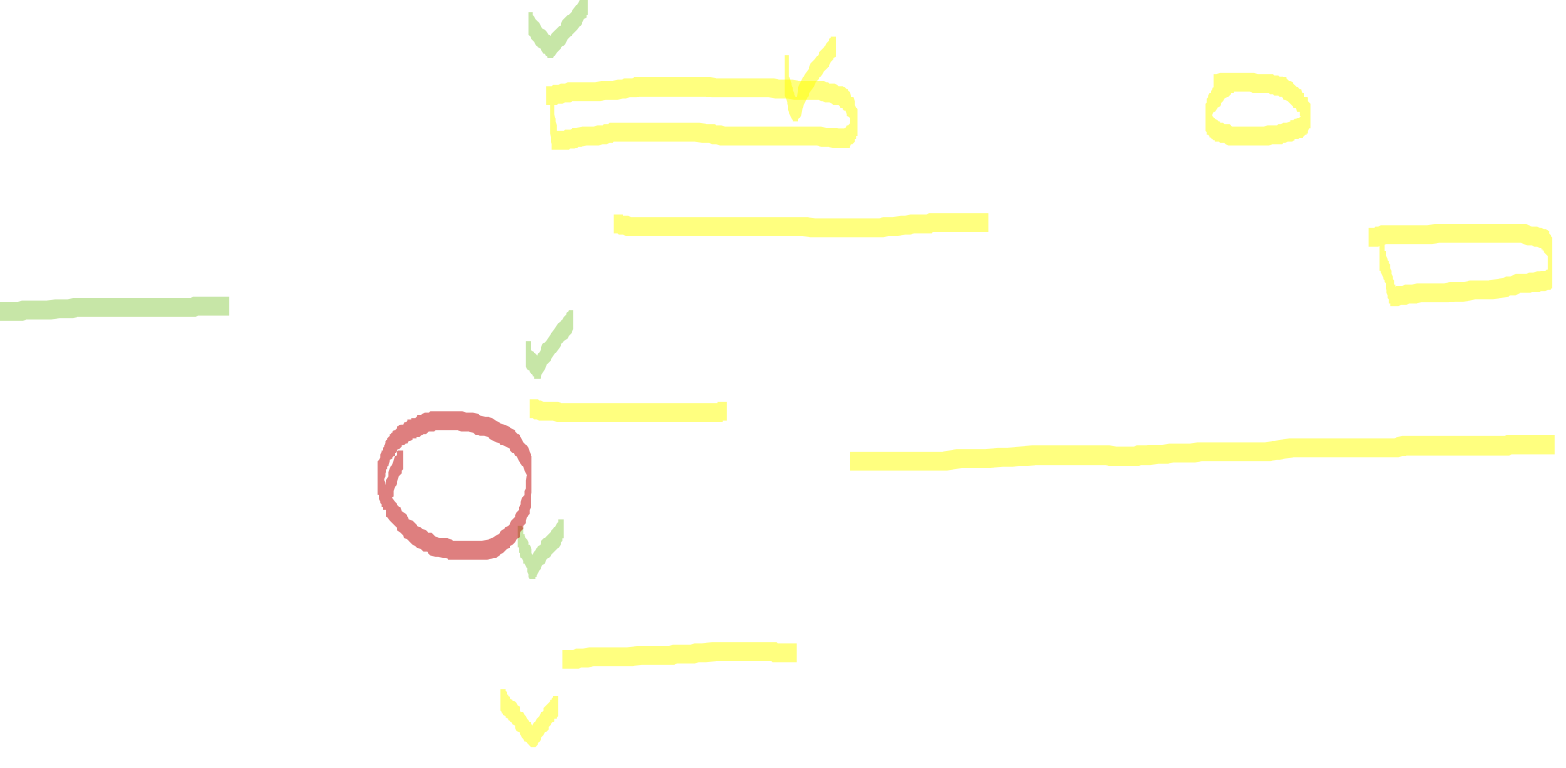
Basics
__global__
· Runs on the device. You can call it from the host, but not from the device.
· Can be used to designate a kernel function to be executed as a device.
· The return value is always void.
· Blocks and threads can be specified during execution using <<<, >>>.
__device__
· Runs on the device. It can be called from the device, not from the host.
__host__
· Runs on the host. It can be called from the host, not from the device. It becomes a function normally used by the host.
· default
__global__ void kernel( void ) { }
int main() {
kernel <<< 1, 1 >>> ();
printf( "Hello, World!\n" );
}

Slide 16
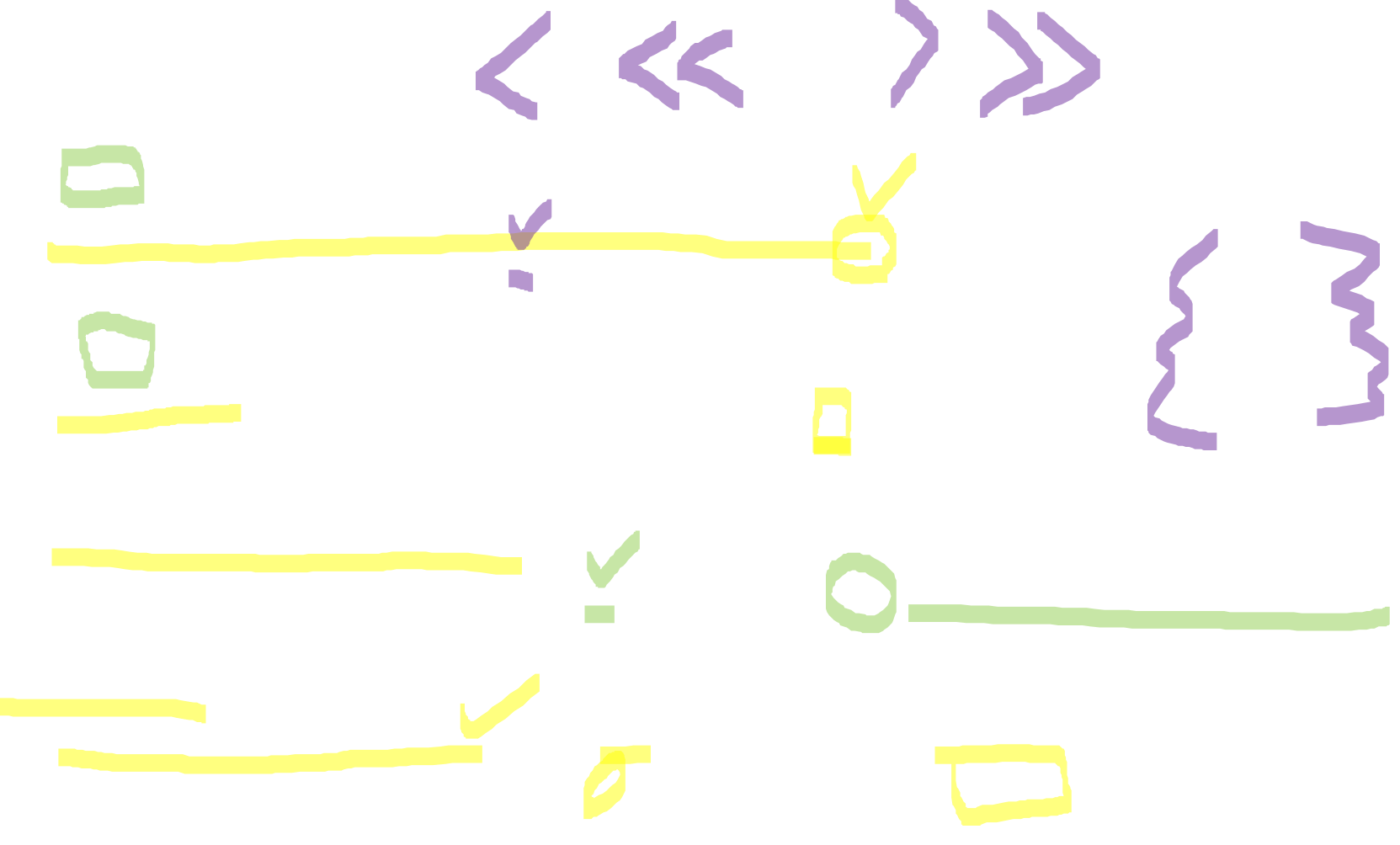
Expressions
gridDim.x
The number of blocks in the grid
For a kernel like performWork << < 2, 4 > >> (), it will be 2.
blockIdx.x
The position index of the block among the blocks in the grid.
It can be 0,1 if you run a kernel like performWork << < 2, 4 > >> ().
blockDim.x:
The number of threads in the block
For a kernel like performWork << < 2, 4 > >> (), it will be 4. All blocks in a grid have the same number of threads.
threadIdx.x:
The position index of the thread in the block.
For a kernel like performWork << < 2, 4 > >> (), it will be one of 0,1,2,3.

Slide 17
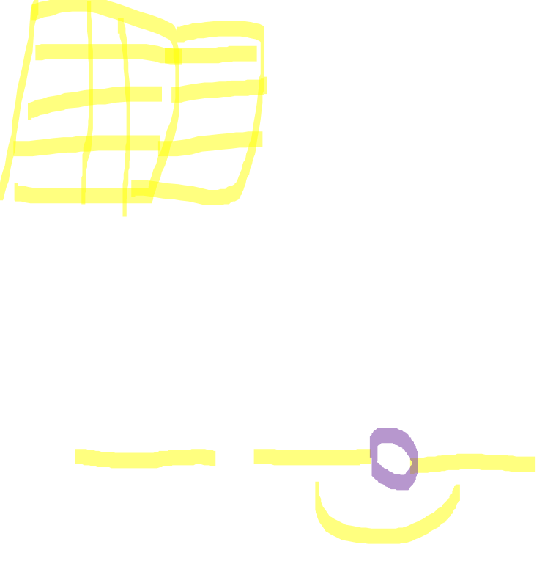
Indexing
index = thread number in block
+ block number * number of threads per block
int index = threadIdx.x + blockIdx.x * blockDim.x(= M);

Slide 18
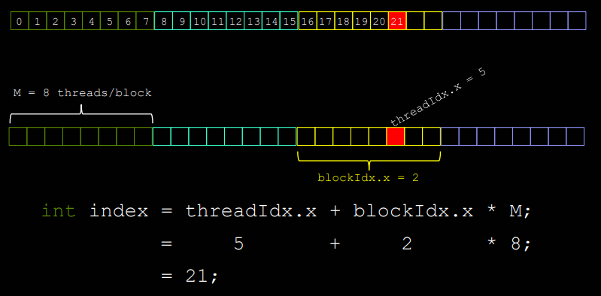
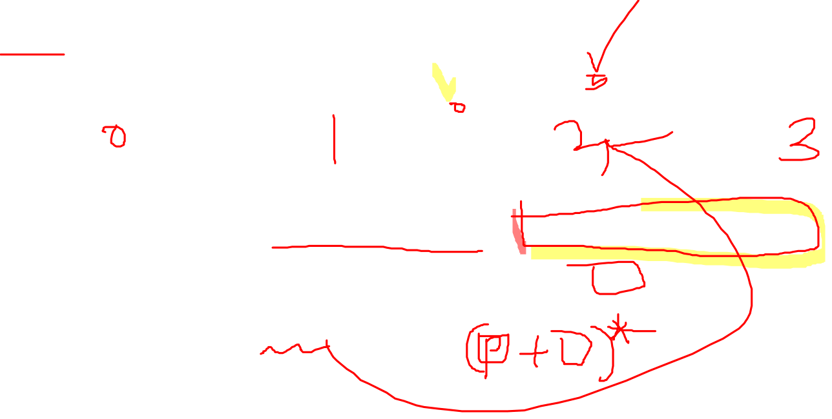
Indexing

Slide 19

Assume data is in a 0 indexed vector
GPU
GPU
DATA
performWork<<<2, 4>>>()
GPU

Slide 20

0
4
Assume data is in a 0 indexed vector
1
5
GPU
GPU
DATA
2
6
3
7
performWork<<<2, 4>>>()
GPU

Slide 21
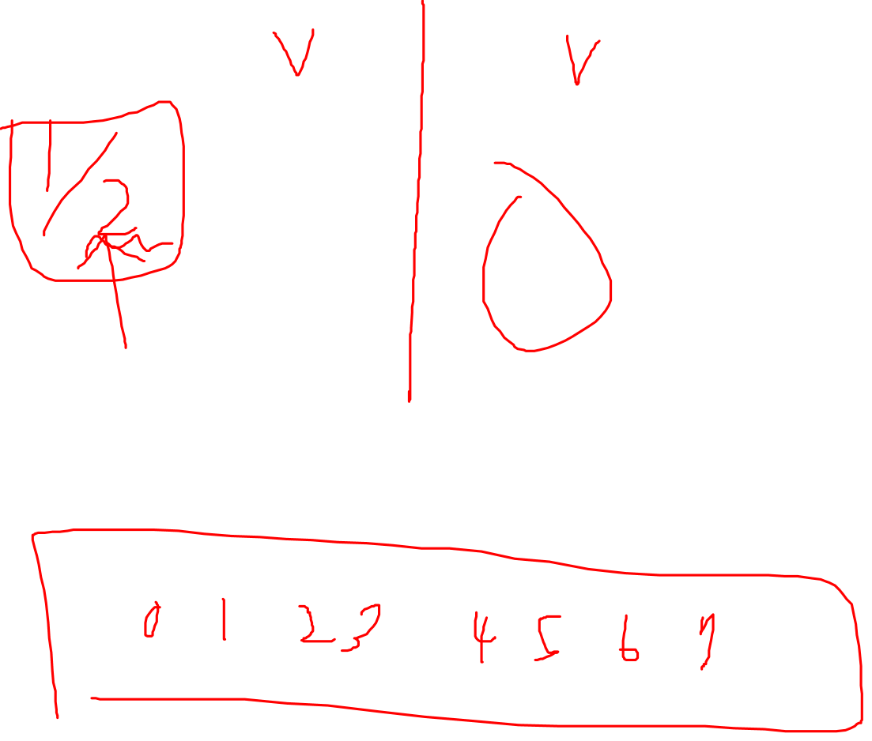
0
4
Somehow, each thread must be mapped to work on an element in the vector
1
5
GPU
GPU
DATA
2
6
3
7
performWork<<<2, 4>>>()
GPU

Slide 22

0
4
Recall that each thread has access to the size of its block via blockDim.x
1
5
GPU
GPU
DATA
2
6
3
7
performWork<<<2, 4>>>()
GPU
4
4

Slide 23

0
4
…and the index of its block within the grid via blockIdx.x
1
5
GPU
GPU
DATA
2
6
3
7
performWork<<<2, 4>>>()
0
1
GPU
4
4

Slide 24
0
4
…and its own index within its block via threadIdx.x
1
5
GPU
GPU
DATA
2
6
3
7
performWork<<<2, 4>>>()
0
1
GPU
0
1
2
3
0
1
2
3
4
4

Slide 25

0
4
Using these variables, the formula threadIdx.x + blockIdx.x * blockDim.x will map each thread to one element in the vector
1
5
GPU
GPU
DATA
2
6
3
7
performWork<<<2, 4>>>()
0
1
GPU
0
1
2
3
0
1
2
3
4
4

Slide 26

0
4
threadIdx.x | + | blockIdx.x | * | blockDim.x
0 |  | 0 |  | 4
1
5
GPU
GPU
DATA
dataIndex
?
2
6
3
7
performWork<<<2, 4>>>()
0
1
GPU
0
1
2
3
0
1
2
3
4
4

Slide 27

0
4
threadIdx.x | + | blockIdx.x | * | blockDim.x
0 |  | 0 |  | 4
1
5
GPU
GPU
DATA
dataIndex
0
2
6
3
7
performWork<<<2, 4>>>()
0
1
GPU
0
1
2
3
0
1
2
3
4
4

Slide 28
0
4
threadIdx.x | + | blockIdx.x | * | blockDim.x
3 |  | 0 |  | 4
1
5
GPU
GPU
DATA
dataIndex
?
2
6
3
7
performWork<<<2, 4>>>()
0
1
GPU
0
1
2
3
0
1
2
3
4
4

Slide 29

0
4
threadIdx.x | + | blockIdx.x | * | blockDim.x
3 |  | 0 |  | 4
1
5
GPU
GPU
DATA
dataIndex
3
2
6
3
7
performWork<<<2, 4>>>()
0
1
GPU
0
1
2
3
0
1
2
3
4
4

Slide 30
0
4
threadIdx.x | + | blockIdx.x | * | blockDim.x
1 |  | 1 |  | 4
1
5
GPU
GPU
DATA
dataIndex
?
2
6
3
7
performWork<<<2, 4>>>()
0
1
GPU
0
1
2
3
0
1
2
3
4
4

Slide 31
0
4
threadIdx.x | + | blockIdx.x | * | blockDim.x
1 |  | 1 |  | 4
1
5
GPU
GPU
DATA
dataIndex
5
2
6
3
7
performWork<<<2, 4>>>()
0
1
GPU
0
1
2
3
0
1
2
3
4
4

Slide 32
Sample
Accelerating a For Loop

Slide 33
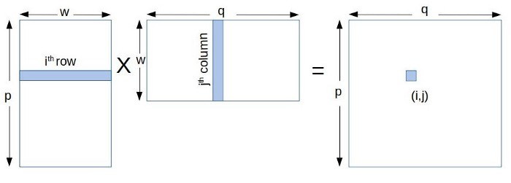
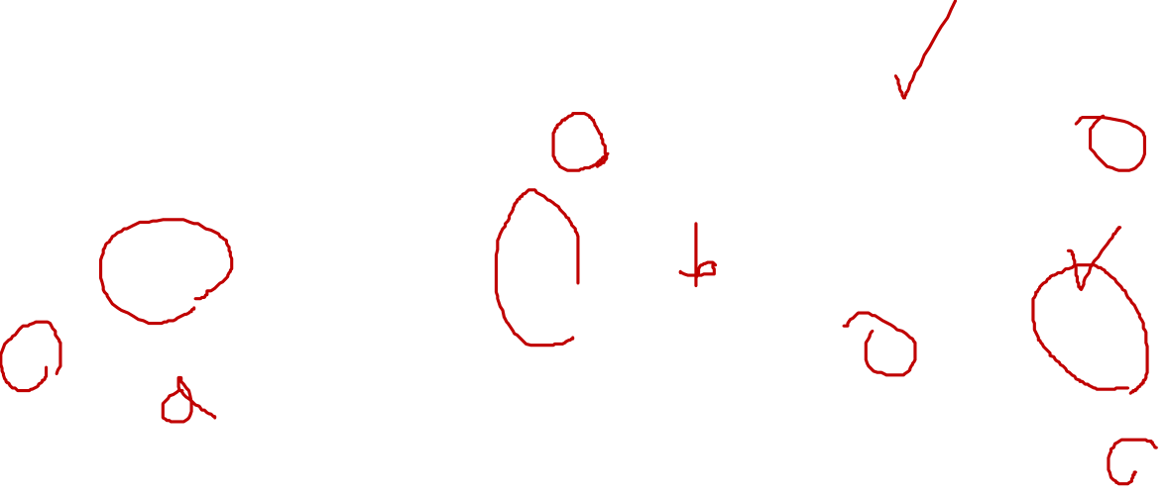
Matrix Multiplication
A is a p × w matrix and B is a w × q matrix
C will be p × q matrix
To calculate (i,j) th element in C we need to multiply ith row of A with jth column in B
-> An individual element in C will be a vector-vector multiplication.

Slide 34
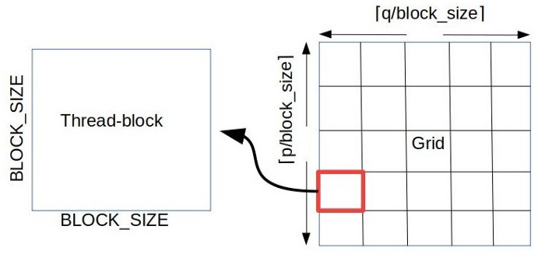

Matrix Multiplication

Slide 35
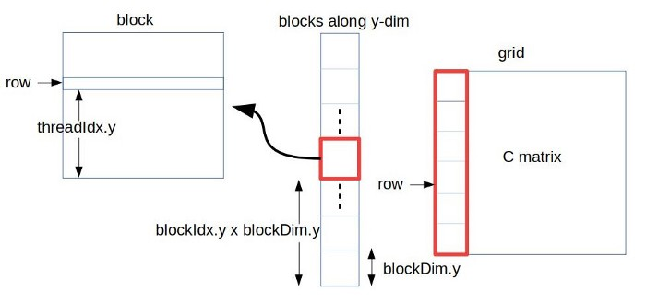
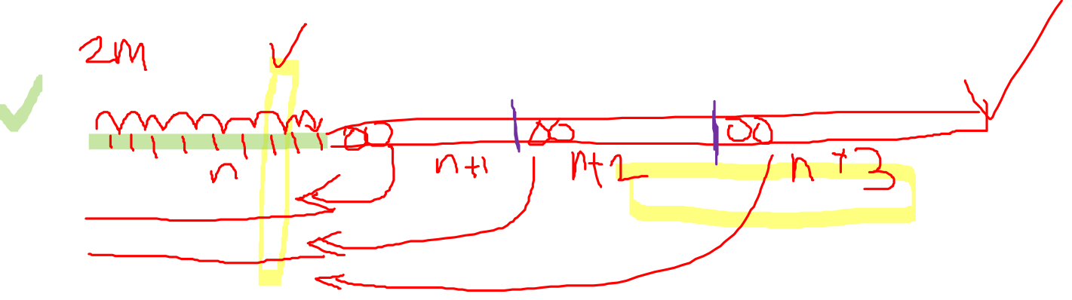
Matrix Multiplication

Slide 36

3d grid
Grids and blocks can be defined to have up to 3 dimensions
Defining them with multiple dimensions does not impact their performance in any way, but can be very helpful when dealing with data that has multiple dimensions, for example, 2d matrices.
dim3 threads_per_block(16, 16, 1);
dim3 number_of_blocks(16, 16, 1);
someKernel<<<number_of_blocks, threads_per_block>>>();

Slide 37
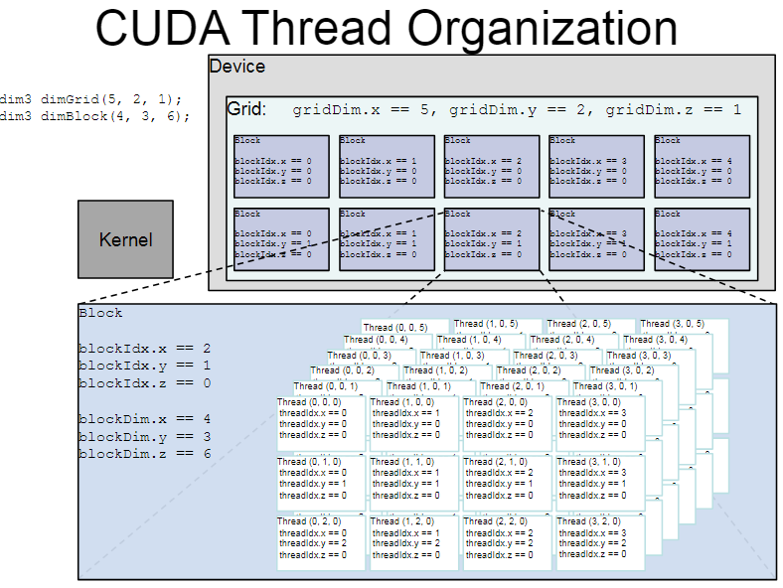
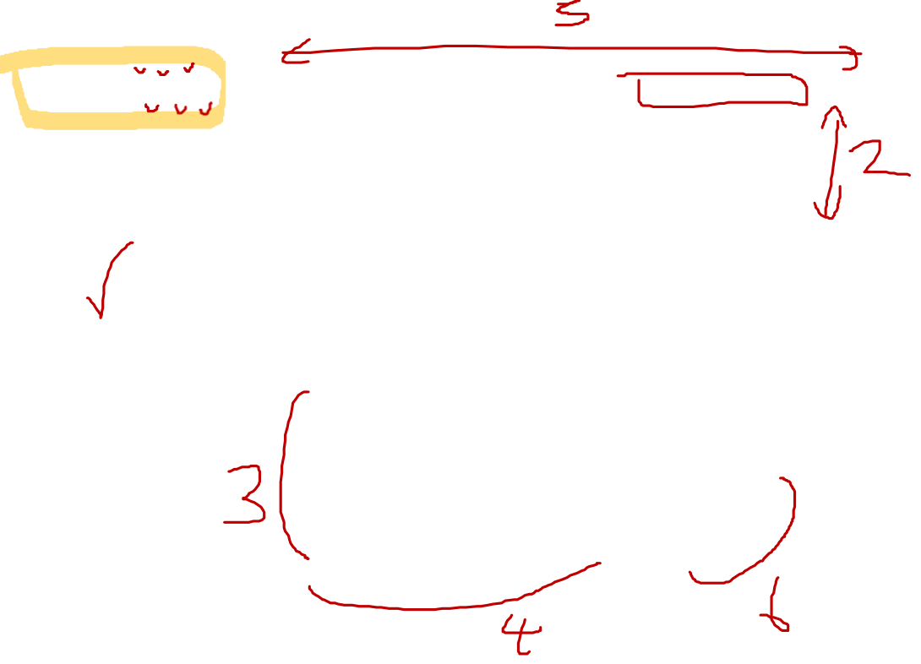
3d grid

Slide 38
Sample
Matrix Multiplication

